Slide 1

Gens & Lens
Making generators composable
by Aleksei Shamenev
Gens & Lens: ジェネレータを合成可能にする

Slide 2
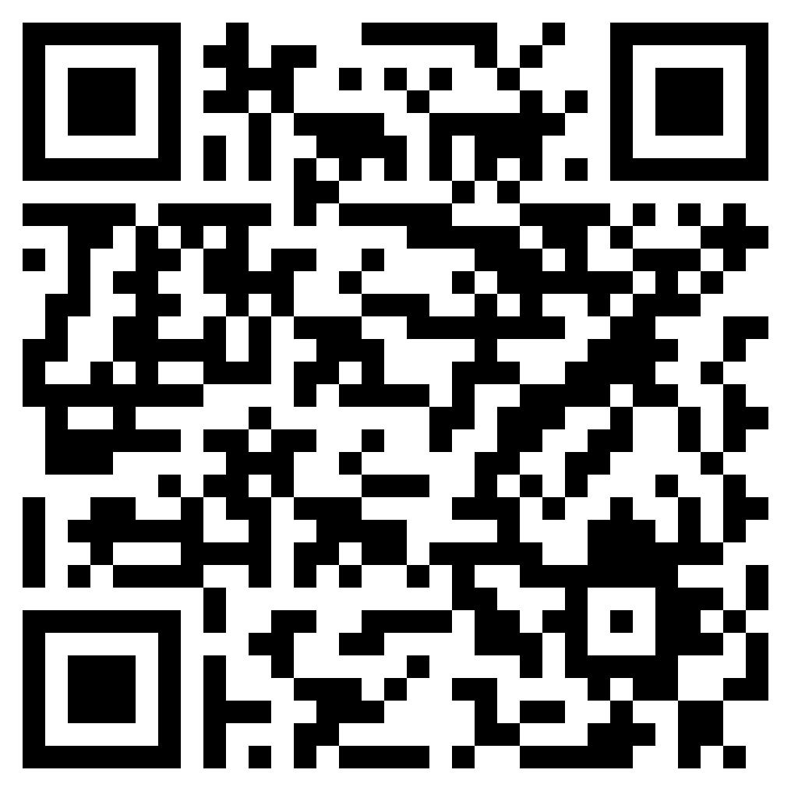
Materials
発表資料です

Slide 3
Agenda
Problem definition
Tech. stack
Composable gens
問題の提起、技術スタック
合成可能な gen

Slide 4
Problem definition
Bank accounts in Westeros
Westeros
Mobile bank service
Lots of corner cases in its validation logic
Using property-based tests for the logic
架空のウェスタロス大陸でモバイル・バンキングを作る
プロパティ・ベースでロジックをテストする

Slide 5
Validation rules
Imaginary world, imaginary regulations
Lots of regions in the world
Lots of different regulations for banks:
Personal bank accounts are forbidden in Westerlands. Both fiat and crypto.
Crownlands allows using cryptocurrencies only for business and don't for personal use.
No cryptocurrencies are legal in Stormlands.
And only Free Cities have no regulations for banks.
地域によって異なる銀行規制。岩の王国では個人口座は禁止。
王室領では、仮想通貨は商用のみ。

Slide 6
Domain
final case class Account private ( accountType: AccountType, billAddress: Address, balance: Balance ) derives Eq
final case class Address(country: Country, city: City) derives Eq
final case class Balance(value: Long, currency: Currency) derives Eq
enum Currency derives Eq: case CoinCurr(fiat: Coins) case CryptoCurr(crypto: Crypto)
ドメイン

Slide 7
Validation rules in Scala
Imaginary world, imaginary regulations
object Account: def make( accountType: AccountType, billAddress: Address, balance: Balance ): Either[ValidationError, Account] = if ( billAddress.country === Country.Westerlands && accountType === AccountType.Personal ) Left(ValidationError.PersonalAccountsForbidden(billAddress.country)) else if (…) // omitted ) Left(…) // omitted else if ( billAddress.country === Country.Stormlands && Currency.isCrypto(balance.currency) ) Left(ValidationError.CryptoForbidden(billAddress.country)) else Right(Account(accountType, billAddress, balance))
Scala での検証ルール

Slide 8
Tech. stack
Scala 3
ScalaCheck
Monocle

Slide 9
ScalaCheck
Property-based tests
Gen[T]
プロパティ・ベース・テスト

Slide 10
Monocle
Access to and transformation of immutable structures
Lens
Optional
不変データ構造のアクセスを補助するライブラリ

Slide 11
Manual composition
Lots of boilerplate code with .copy(..)
property("Crypto is forbidden in Stormlands") { forAll { (accountType: AccountType, address: Address, balance: Balance, anyCrypto: Crypto) => val stormlands = address.copy(country = Country.Stormlands) val cryptoCurr = Currency.CryptoCurr(anyCrypto) val cryptoBalance = balance.copy(currency = cryptoCurr) val result = Account.make(accountType, stormlands, cryptoBalance) (result === Left(ValidationError.CryptoForbidden(Country.Stormlands))) :| s"result = $result" } }
.copy(...) を何度も手で書くのが面倒

Slide 12
Using Monocle
Optics definition
object DomainLens: val AddressCountryLens: Lens[Address, Country] = GenLens[Address](_.country) val AddressCityLens: Lens[Address, City] = GenLens[Address](_.city) val BalanceCurrencyLens: Lens[Balance, Currency] = GenLens[Balance](_.currency) val CurrencyCryptoOptional: Optional[Currency, Crypto] = ??? // omitted val BalanceCryptoOptional: Optional[Balance, Crypto] = BalanceCurrencyLens.andThen(CurrencyCryptoOptional)
Monocle を使うときれいに書ける

Slide 13
Using Monocle
DSL
object LensDSL: final case class BySetterStep[F[_], A, B](fa: F[A], setter: Setter[A, B]): infix def byF(fb: F[B])(using Monad[F]): F[A] = for { a <- fa b <- fb } yield setter.replace(b)(a) infix def by(b: B)(using Monad[F]): F[A] = for { a <- fa } yield setter.replace(b)(a)

Slide 14
Using Monocle
Test case
property("Crypto is forbidden in Stormlands") { val patchedAddressGen = addressGen replace AddressCountryLens by Country.Stormlands val patchedBalanceGen = balanceGen replace BalanceCryptoOptional byF cryptoGen forAll(accountTypeGen, patchedAddressGen, patchedBalanceGen) { (accountType, address, balance) => val result = Account.make(accountType, address, balance) (result === Left(ValidationError.CryptoForbidden(Country.Stormlands))) :| s"result = $result" } }

Slide 15
Implicit optics
Define optics using `given`
object GivenDomainLens: given Lens[Address, Country] = DomainLens.AddressCountryLens given Lens[Address, City] = DomainLens.AddressCityLens given Lens[Balance, Currency] = DomainLens.BalanceCurrencyLens given Optional[Currency, Crypto] = DomainLens.CurrencyCryptoOptional given Optional[Balance, Crypto] = DomainLens.BalanceCryptoOptional
given を使ったオプティクスの定義

Slide 16
Implicit optics
DSL
object GivenLensDSL: extension [F[_], A](fa: F[A]) infix def by[B](b: B)(using setter: Setter[A, B], m: Monad[F]): F[A] = for a <- fa yield setter.replace(b)(a) infix def byF[B](fb: F[B])(using opti: Optional[A, B], m: Monad[F]): F[A] = for a <- fa b <- fb yield opti.replace(b)(a)

Slide 17
Implcit optics
Test case
property("Crypto is forbidden in Stormlands") { val patchedAddressGen = addressGen by Country.Stormlands val patchedBalanceGen = balanceGen byF cryptoGen forAll(accountTypeGen, patchedAddressGen, patchedBalanceGen) { (accountType, address, balance) => val result = Account.make(accountType, address, balance) (result === Left(ValidationError.CryptoForbidden(Country.Stormlands))) :| s"result = $result" } }

Slide 18
Auto Derivation
Further work
Optics autoderivation
No need to explicitly define optics
More requirements to the structures
Unique types for fields within the structure of cases classes
Or explicit markup of fields
今後の課題はオプティクスの自動導出

Slide 19
The End
ご清聴ありがとうございました

